Slide 2
Learning objectives
In this lesson you will learn to:
  define what is meant by the terms: 'binary' and 'bit’
  explain why binary is used to represent data and program instructions in a computer
  describe the relationship between the number of bits and the range of values that can be represented by them.
For more detail on this topic, and additional student activities, refer to Topic 2 of the student book.
© Pearson Education Ltd 2020. Copying permitted for purchasing institution only.
Notes:
Specification content: 2.1.1 2.1.2 2.2.4 2.31

Slide 3

What is binary and why do we use it?
These are transistors.
They are tiny electrical components that form the basis of all digital computing devices.
They have two distinct states (on and off) that we use the binary digits 1 and 0 to represent.
Why is it called binary?
Because ‘bi’ means two. There are two available digits that we can use (1 and 0), so the number system is called binary.
The normal numbers that we are familiar with (0-9) are known as denary (ten) digits.
© Pearson Education Ltd 2020. Copying permitted for purchasing institution only.
Notes:
For more detail, see Craig n Dave video: https://student.craigndave.org/videos/gcse-edexcel-topic-2a-number-bases

Slide 4
What kinds of data do we store?
Think about your mobile phone.
What data do you access, create or store on it?
All data is represented in a computer as patterns of bits.
A bit is the smallest unit of information that can be processed inside a computer.
A bit can hold one of two symbols: 0 or 1.
© Pearson Education Ltd 2020. Copying permitted for purchasing institution only.

Slide 5
So what are we looking at?
0110100001100101011011000110110001101111001000000111011101101111011100100110110001100100
What might this binary pattern represent?
How does a computer know how to interpret it?
Every type of data has to be encoded using an agreed method (or standard) so that the computer is able to handle it.
Different types of files use different methods to encode data. For example, JPEGs are organised in one way and text files in a completely different way. But the data in all types of file is represented in binary.
© Pearson Education Ltd 2020. Copying permitted for purchasing institution only.
Notes:
NOTE: the binary is text: “hello world” in ASCII encoding
CraignDave video: https://student.craigndave.org/videos/gcse-edexcel-topic-2a-bit-patterns

Slide 6

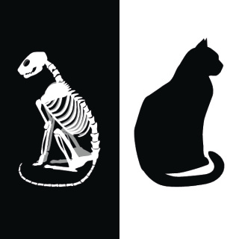

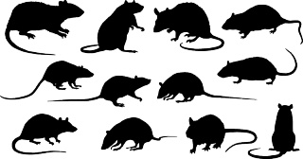
Encoding
Let’s say you want to use binary to represent and uniquely identify pets.
If you have 4 pets, you can represent them using 2 binary digits (or bits) like so:
00
01
10
11
What if you want to represent goldfish or ferrets as well?
How could you improve this encoding system?
© Pearson Education Ltd 2020. Copying permitted for purchasing institution only.

Slide 7
What if we want more?
With 3 bits, we can represent and uniquely identify eight different types of pet. But what if we want to do more than that?
All encoding schemes have this same limitation: the number of available bits constrains the number of possible unique values that can be represented.
Sometimes, compromises have to be made – in this instance, not all pets can be given their own identifier.
Rather than identifying individual pets perhaps it would be better to identify groups of animals with similar characteristics, e.g. animals with 4 legs and fur, creatures with no legs, creatures with 8 legs, etc. …).
© Pearson Education Ltd 2020. Copying permitted for purchasing institution only.
Notes:
Activity 1

Slide 8
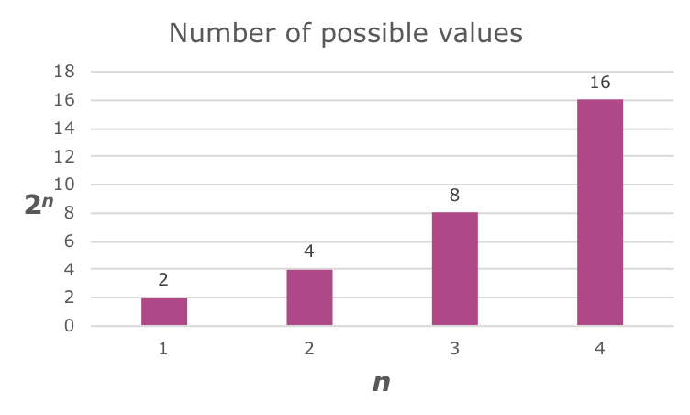
How many patterns?
It is possible to calculate how many unique bit patterns are available for a set number of bits.
This can be generalised to 2^{n} where n is the number of bits available
Let’s see if you can spot the pattern:
  With 1 bit, you can represent 2 values
  With 2 bits, you can represent 4 values
  With 3 bits, you can represent 8 values
  With 4 bits, you can represent 16 values
© Pearson Education Ltd 2020. Copying permitted for purchasing institution only.
Notes:
Note: this can also be written as 2^n
Activity 2

Slide 9
How many bits?
You may also need to decide how many bits you need to use to represent a given number of values.
A simple way to do this is find the closest number using the previous calculation.
For example:
We need to represent 19 values in binary.
Using 2^{n} we know that:
2 bits can represent 4 values
4 bits can represent 16 values This value is the closest, but there are not enough bits to represent all of the values.
5 bits can represent 32 values We need to use 5 bits to represent them all.
© Pearson Education Ltd 2020. Copying permitted for purchasing institution only.
Notes:
Activity 3

Slide 10
Wrap up: you have learned how to…
Define the terms 'binary' and 'bit’.
  Binary is a number system that uses 2 digits, 1 and 0.
  A bit is one digit of a binary number. It is a shortened version of the phrase ‘binary digit’.
Explain why binary is used to represent data and program instructions in a computer.
  Digital computers are based on transistors which have two discrete states. We use 1 and 0 to represent these states.
Describe the relationship between the number of bits and the number of values that can be represented.
  We can calculate the number of values using 2^{n}, where n is the number of bits.
© Pearson Education Ltd 2020. Copying permitted for purchasing institution only.

